Slide 1

ACE IT —
IT
ACE IT ACE AE IT ACE IT ACE IT ACE
Mohammed Hossain
Sabahat Meah
Ayaan Choudhury
Oheen Rahman

Slide 2
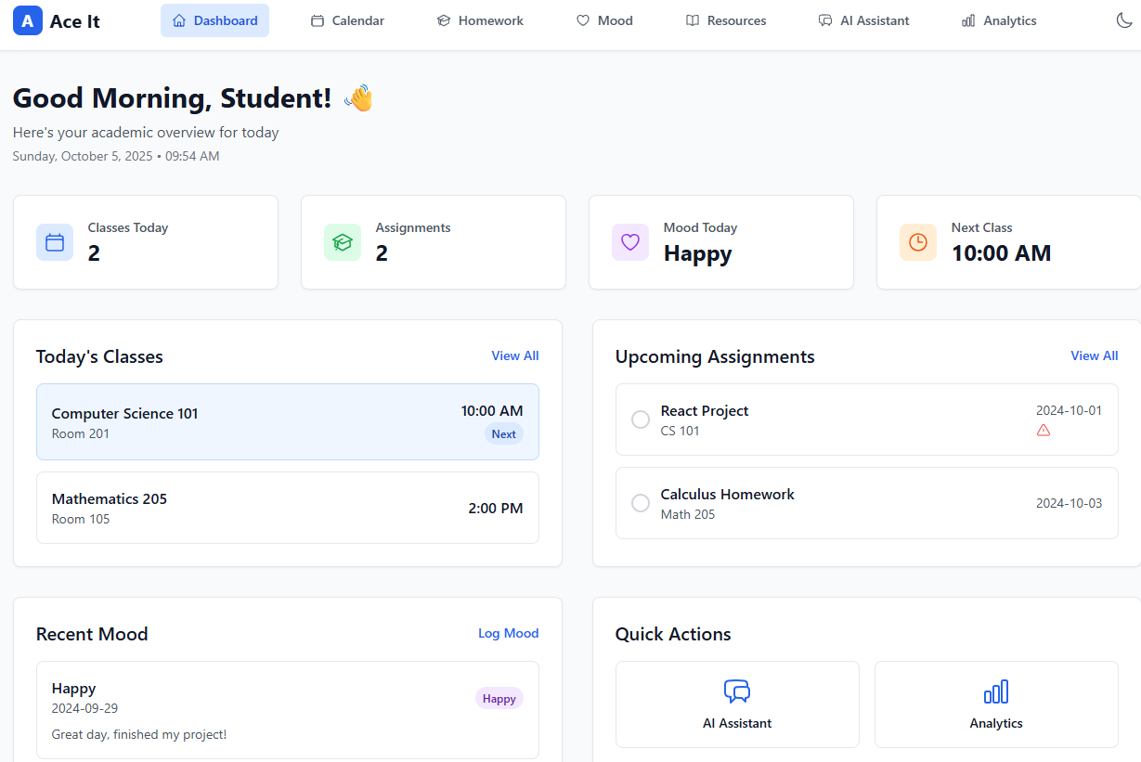
Functionality
1.
2.
How our app works
Helps students manage stress. Tracks moods to identify patterns and manage mental health.
Implemented helpful resources for learning and personal well-being.
3.
4.
Convenience in scheduling classes and a homework tracker to stay on top of work.
See all completed and necessary academic and health information altogether in analytics.

Slide 3

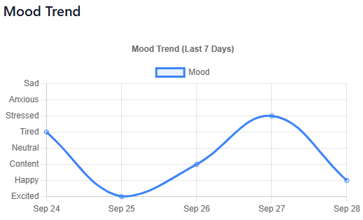

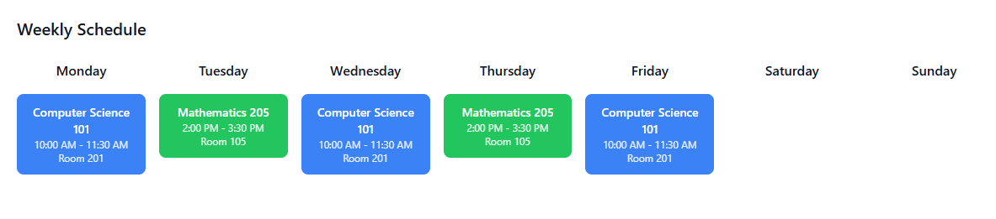
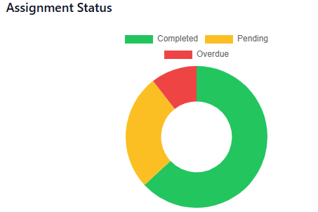

AI Assistant
Features
Mood Tracking
Built-in Calendar
Student Resources
Overall Analytics
Convenient Functionality

Slide 4


Demo
A
Ace It

Slide 5





Tech Stack

Slide 6

Future Plans
AI Assistant (Gemini/OpenAI)
Authentication & Accounts
Data & Storage
Analytics & Personalization

Slide 7

Thank You!
Mohammed H
Sabahat M
Oheen R
Ayaan C
Ace It
CS & Math LinkedIn Portfolio Site
CS & Data Science LinkedIn
Data Science & Econ LinkedIn Portfolio Site
CS & Business LinkedIn
Demo GitHub

